Slide 1
Global E-Commerce Sales & Customer Analytics Dashboard
Capstone Project using Power BI & DAX

Slide 2
Acknowledgement
I would like to express my sincere gratitude to my mentors, instructors, and learning resources for their guidance throughout this project. This project demonstrates end-to-end analytics using Power BI and DAX.

Slide 3
Project Objective
• Analyze customer behavior and purchasing patterns
• Evaluate product performance and sales trends
• Monitor customer satisfaction through reviews
• Identify high-value customers and top-performing products
• Build interactive dashboards for business decision-making

Slide 4
Project Workflow
Step 1: Data Understanding & Preparation
Step 2: Data Modeling & Relationships
Step 3: DAX Measures & KPI Creation
Step 4: Dashboard Development in Power BI
Step 5: Business Insights & Recommendations

Slide 5
Dataset Overview
Tables Used:
• Customers
• Products
• Orders
• Order Items
• Product Reviews

Slide 6
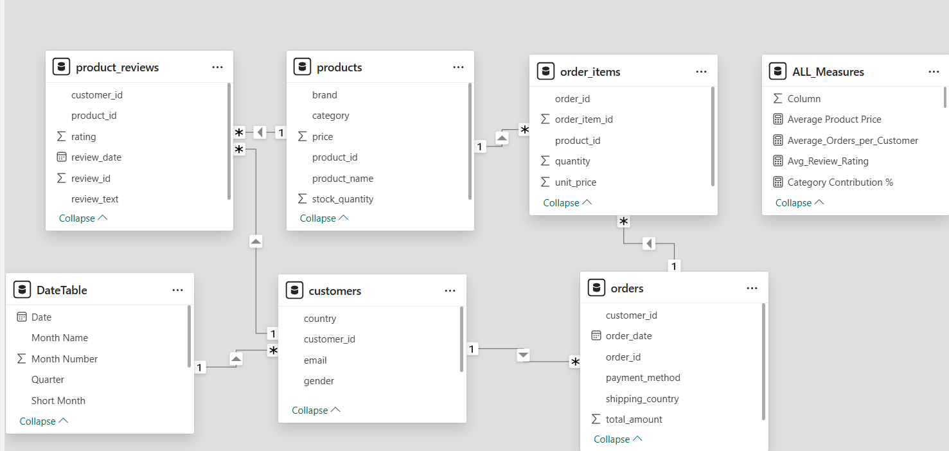
Data Modeling (ERD)

Slide 7
Power BI Dashboard
Developed 3 Dashboards:
1. Customer Overview
2. Product Performance
3. Customer Review & Satisfaction

Slide 8
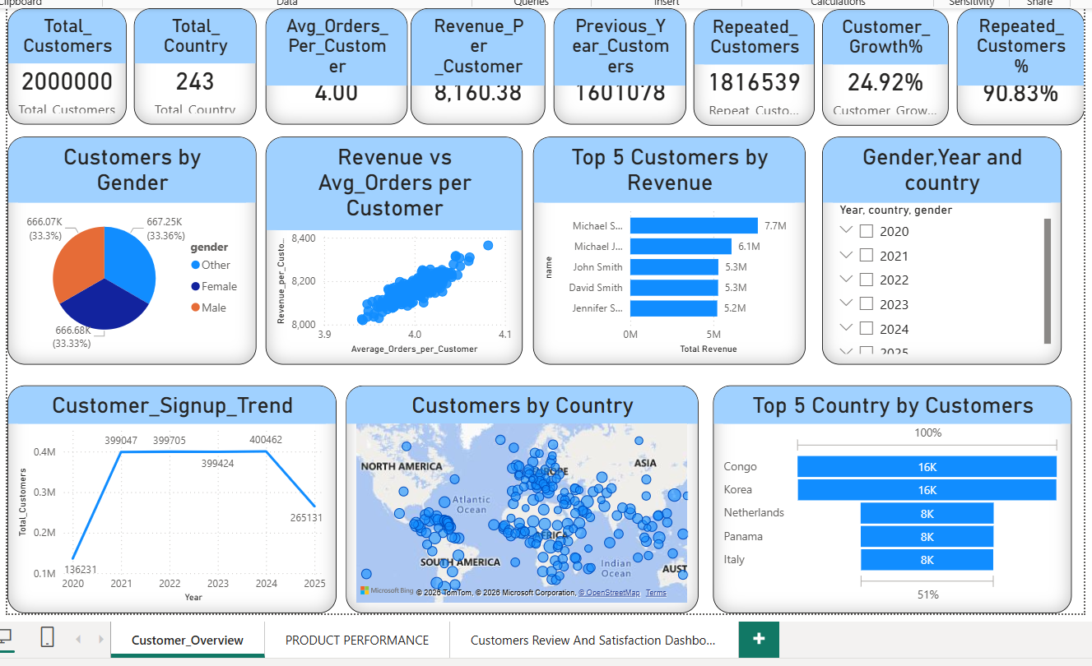
Customer Overview Dashboard

Slide 9
Customer Overview - Key Insights
• Customer base grew by 24.92% compared to previous year.
• Repeat customer rate reached 90.83%.
• Customers place an average of 4 orders.
• Revenue per customer exceeds 8K.
• Customer distribution is balanced across genders.
• Top customers contribute significant revenue.

Slide 10
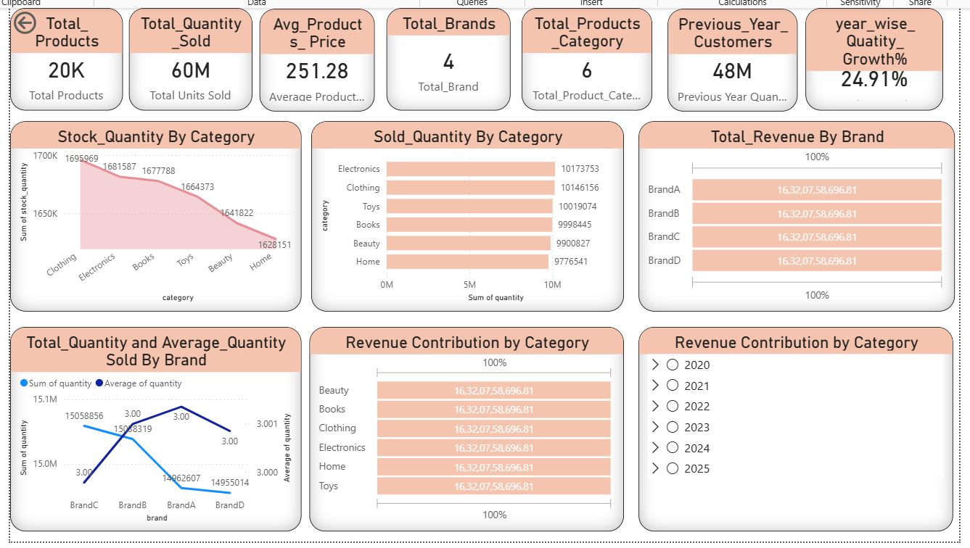
Product Performance Dashboard

Slide 11
Product Performance - Key Insights
• Total quantity sold exceeded 60 million units.
• Product demand increased by 24.91% year-over-year.
• Electronics is the highest-selling category.
• Home category recorded the lowest sales volume.
• Average product price is 251.28.
• Revenue is distributed across multiple brands.

Slide 12
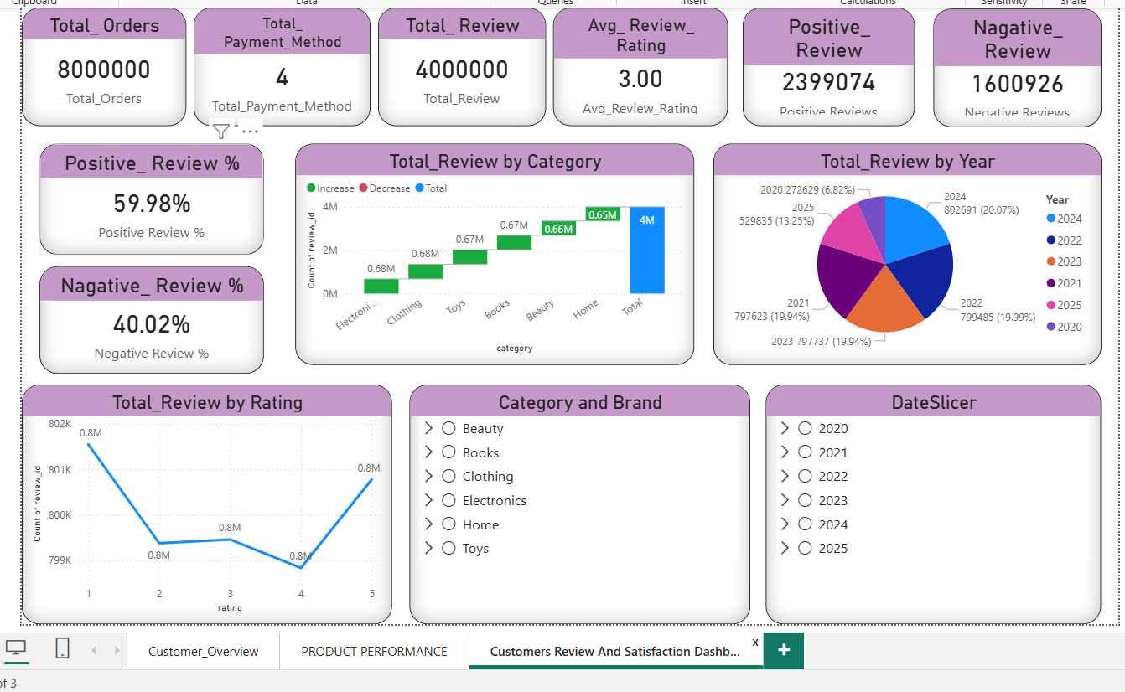
Customer Review & Satisfaction Dashboard

Slide 13
Review & Satisfaction - Key Insights
• Positive reviews account for nearly 60% of all reviews.
• Average product rating is 3 out of 5.
• Electronics receives the highest review volume.
• Review activity remains strong across years.
• Negative reviews highlight improvement opportunities.
• More than 4 million reviews were analyzed.

Slide 14
Overall Business Insights
• Strong customer retention and growth.
• Increasing product demand across categories.
• Electronics is the leading category in sales and reviews.
• Customer satisfaction is moderate with scope for improvement.
• Review participation provides valuable business feedback.
• Dashboards support data-driven decision-making.

Slide 15
Future Scope
• Customer Segmentation (RFM)
• Sales Forecasting
• Recommendation System
• Sentiment Analysis
• Real-Time Dashboard Integration

Slide 16
References
• Synthetic E-Commerce Dataset
• Power BI Documentation
• Microsoft DAX Documentation

Slide 17
Thank You

